Slide 1
PHD Club 🚀📚
Organized by Noura, Quentin and Eliott 👥​

Slide 2
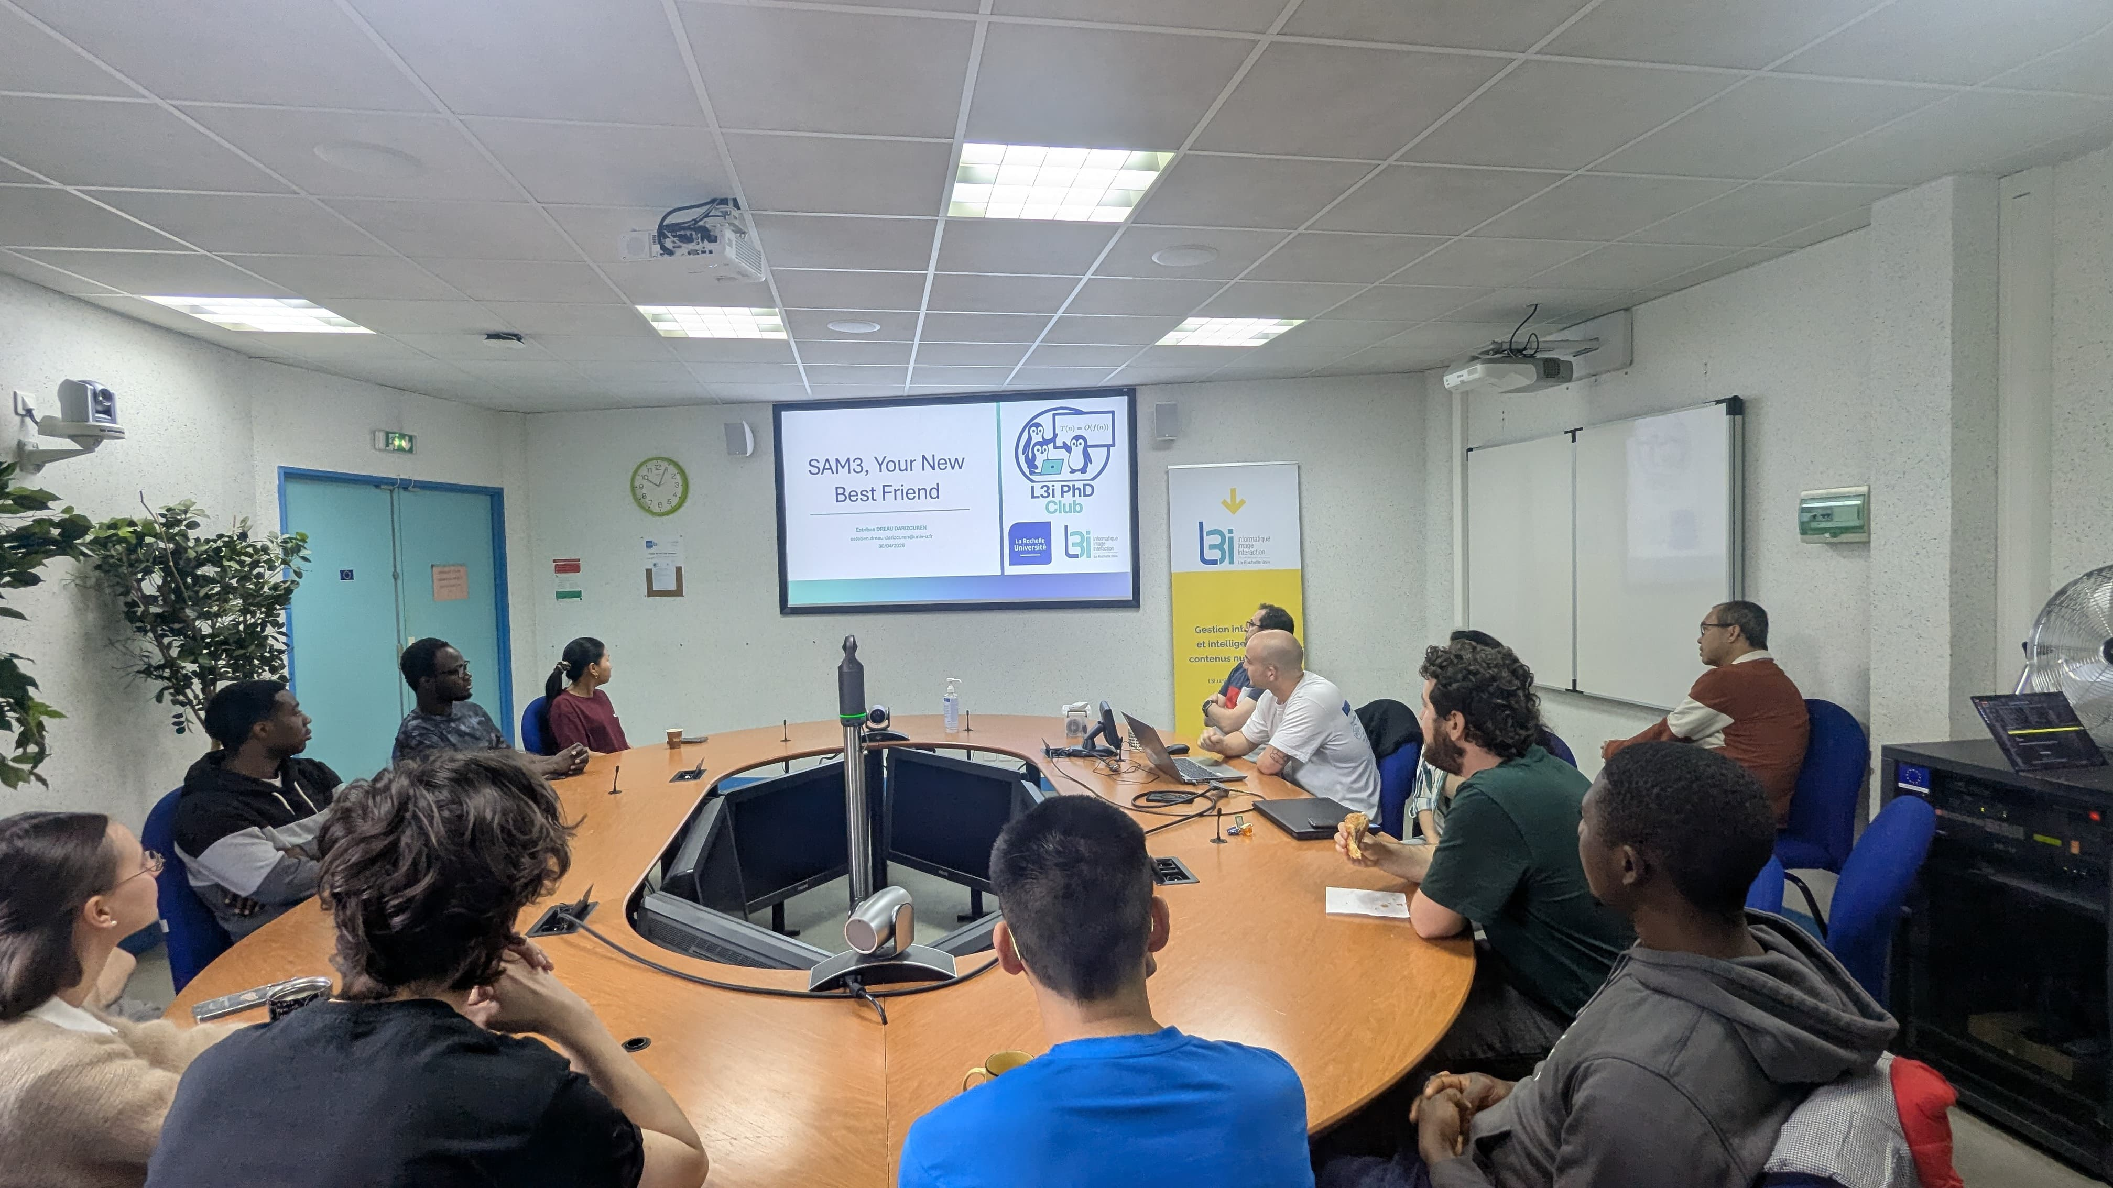
What and Why?​
Weekly 15-minutes gatherings to share insights and experiences 🤝
15 minutes total​
  5 min setup/transition ⏱️​
  5 min presentation 🗣️​
  5 min Q&A ❓
Share experience, information, ideas
Informal Learning
Break down team barriers 🧱➡️
Create a more dynamic and collaborative lab environment 🔬🤖

Slide 3
Participation​
Every PhD student gets a presentation slot (once a year) 📋​
If your assigned date doesn’t suit you, swap with a colleague if necessary 🔄
No pressure, just an opportunity to share 😌​
Preparation time should be minimal 📄
In-person preferred, but remote option available 🏢💻​

Slide 4
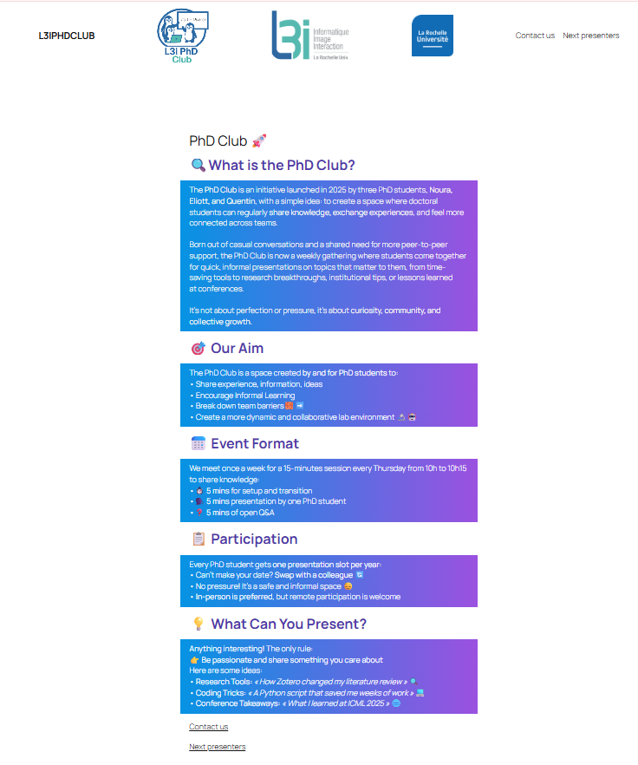
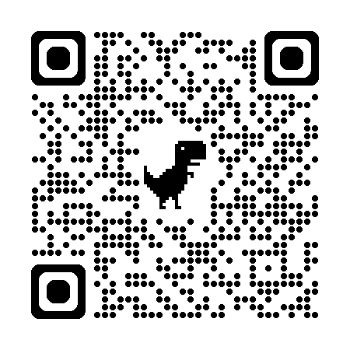
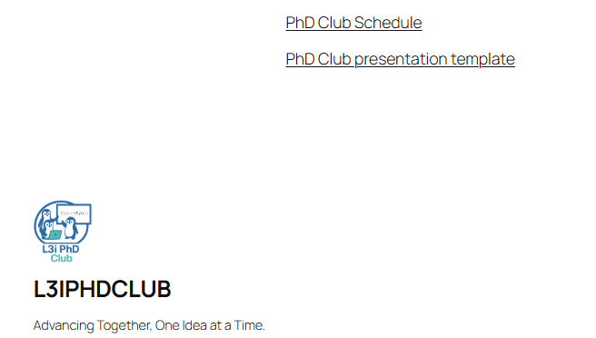
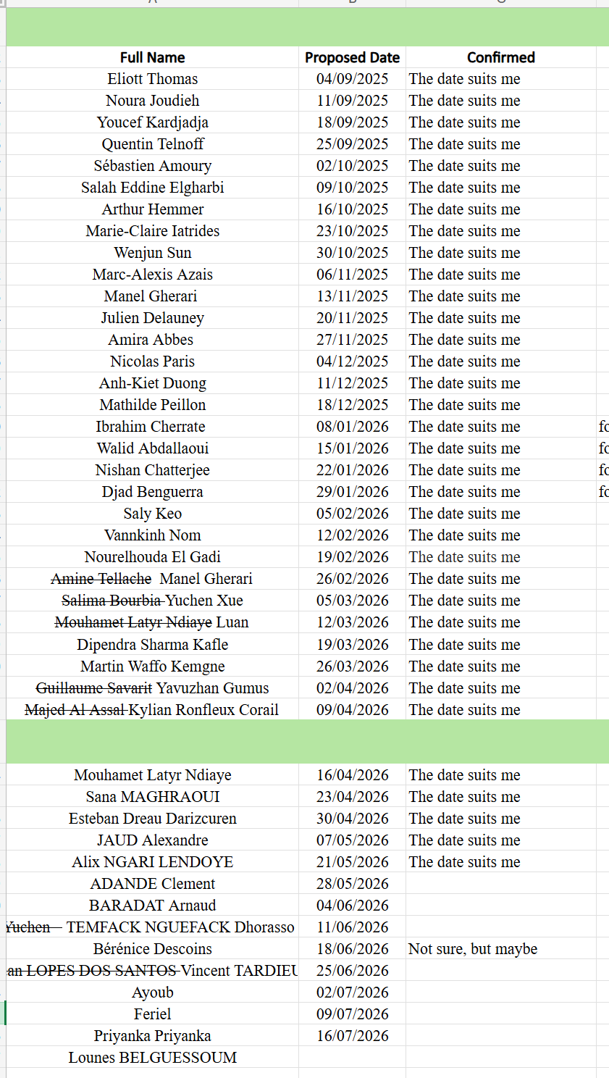
Practical Details​
Slides template are available on the website (Next presenters → Scroll to the end of page)
You will find the past presentations and next presenters
Check our website: ​
https://l3iphdclub.univ-lr.fr/

Slide 5
Some Ideas for Presentation Themes ☺ ​
Theme | Examples
Generative AI Tools | AI-assisted tools, dataset walkthroughs, scene text demos
PhD Research Careers | Conference tips, academia vs industry, mobility advice
Research Skills | How to write a review, structuring results, paper writing
Python & ML Tooling | Useful libraries, experiment tracking, coding workflows
...
The only rule: Be passionate and share something you find exciting!

Slide 6
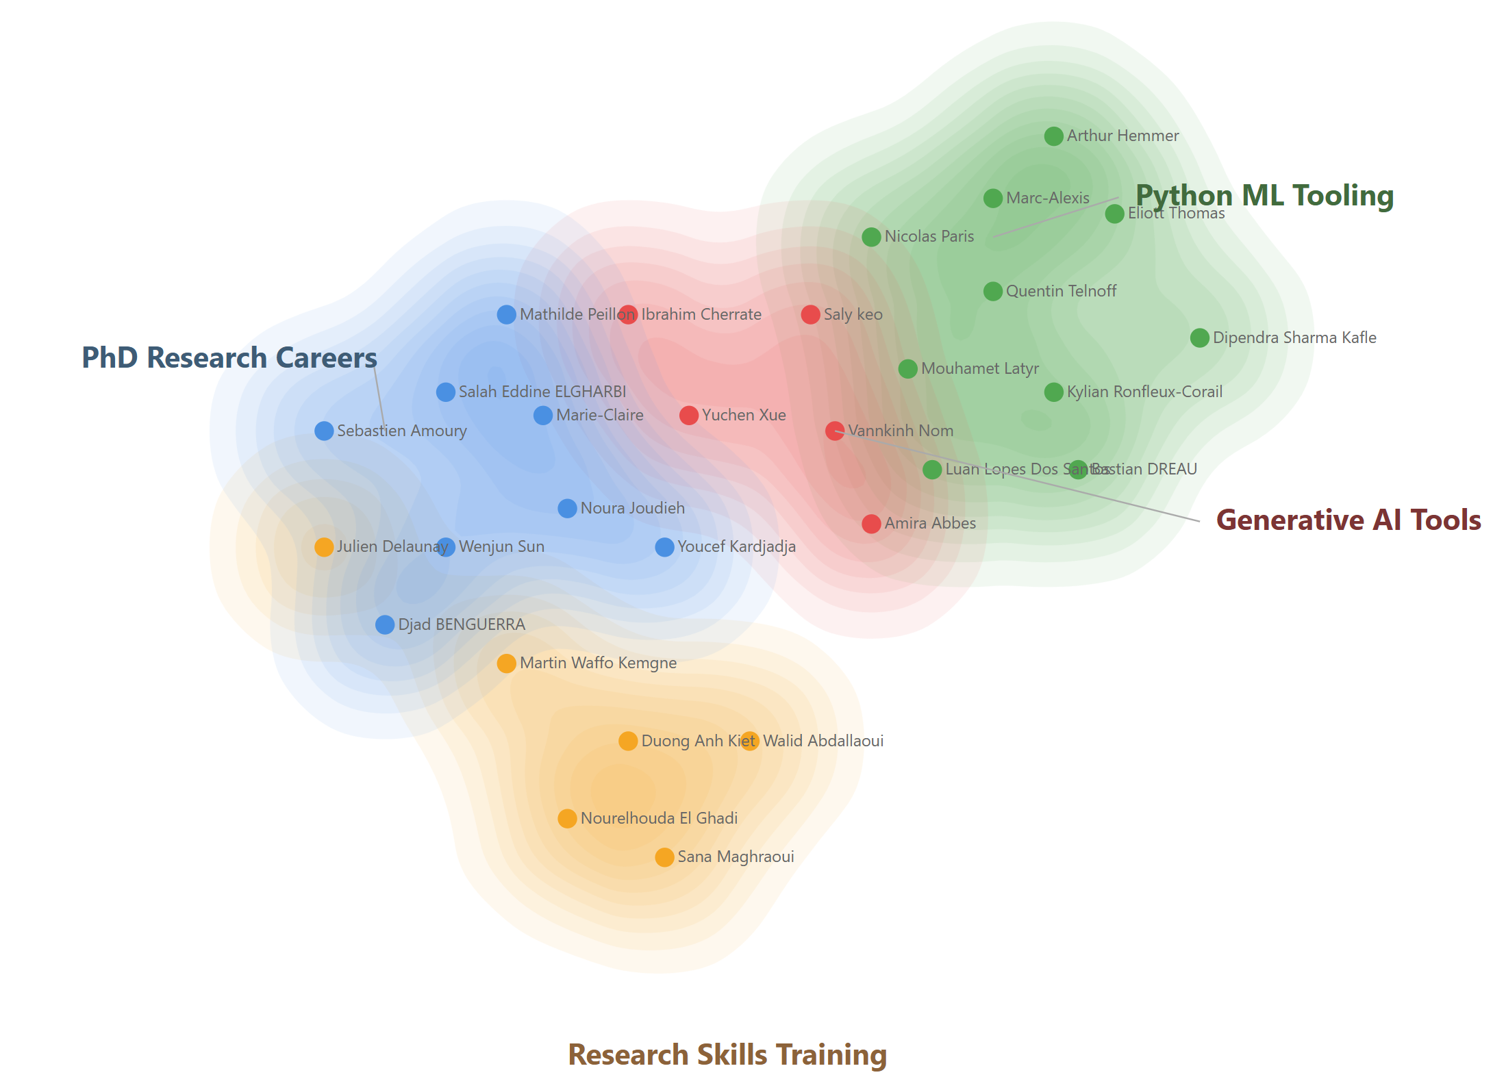
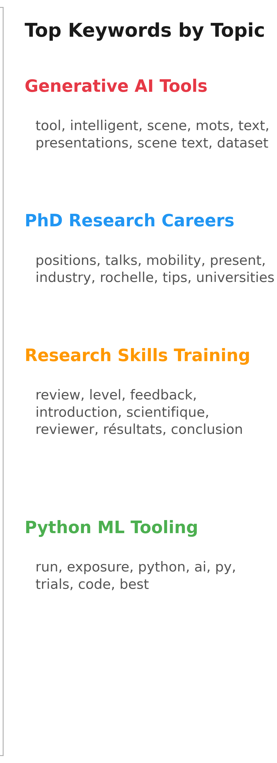
The first year of the PhD Club☺ ​
33 presentations so far !!

Slide 7

Join Us!​
Open to all L3i members to attend 🚪​
Only PhD students will present 🎤​
Bring your curiosity, share your insights 💡
Let's make our lab more connected! 🤝
Join Us!
A call for new board members !

Slide 8
PHD Club 🚀📚
Organized by Noura, Quentin and Eliott 👥​

